Slide 1
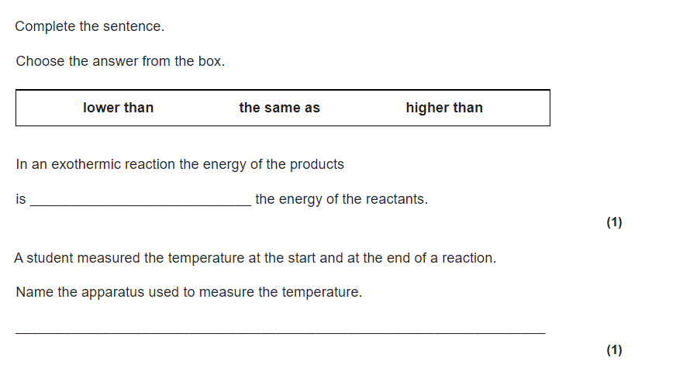
Copy and answer questions in your books
lower than
thermometer

Slide 3
Required Practical- Temperature Change
Keywords
temperature
carbonate
variable

Slide 4
Learning objectives:
use scientific theories and explanations to develop hypotheses
plan experiments to make observations and test hypotheses
evaluate methods to suggest possible improvements and further investigations.

Slide 5
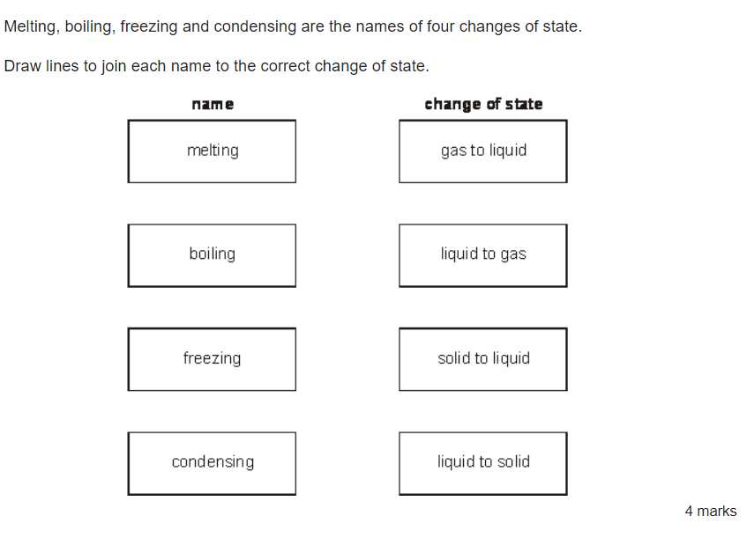
Do Now- in the front of your book answer the questions below

Slide 6
Equipment
Dilute hydrochloric acid
Dilute sodium hydroxide solution
polystyrene cup and lid
250 cm3 beaker
10cm3 measuring cylinder
50cm³ measuring cylinder
A thermometer
Safety goggles

Slide 7
Method
1.Measure 30cm³ dilute hydrochloric acid and put it into the polystyrene cup.
2.Stand the cup inside the beaker. This will make it more stable
3.Use the thermometer to measure the temperature of the acid. Record your result in the table.
4.Measure 5cm³ sodium hydroxide solution.
5.Pour the sodium hydroxide into the polystyrene cup. Fit the lid and gently stir the solution with the thermometer through the hole.
6.Look carefully at the temperature rise on the thermometer.
7.When the reading on the thermometer stops changing, record the highest temperature reached in the table.
8.Repeat steps 4-7 to add further 5cm³ amounts of sodium hydroxide to the cup each time, recording your temperature reading in the results table.
9.Repeat until a maximum of 40cm³ of sodium hydroxide has been added.
10.Wash out all the equipment and repeat the experiment for your second trial.
https://www.youtube.com/watch?v=tKxcQYZ2YH8&t=168s

Slide 8
Method
1.Measure 30cm³ dilute hydrochloric acid and put it into the polystyrene cup.
2.Stand the cup inside the beaker. This will make it more stable
3.Use the thermometer to measure the temperature of the acid. Record your result in the table.
4.Measure 5cm³ sodium hydroxide solution.
5.Pour the sodium hydroxide into the polystyrene cup. Fit the lid and gently stir the solution with the thermometer through the hole.
6.Look carefully at the temperature rise on the thermometer.
7.When the reading on the thermometer stops changing, record the highest temperature reached in the table.
8.Repeat steps 4-7 to add further 5cm³ amounts of sodium hydroxide to the cup each time, recording your temperature reading in the results table.
9.Repeat until a maximum of 40cm³ of sodium hydroxide has been added.
10.Wash out all the equipment and repeat the experiment for your second trial.
https://www.youtube.com/watch?v=tKxcQYZ2YH8&t=168s

Slide 9
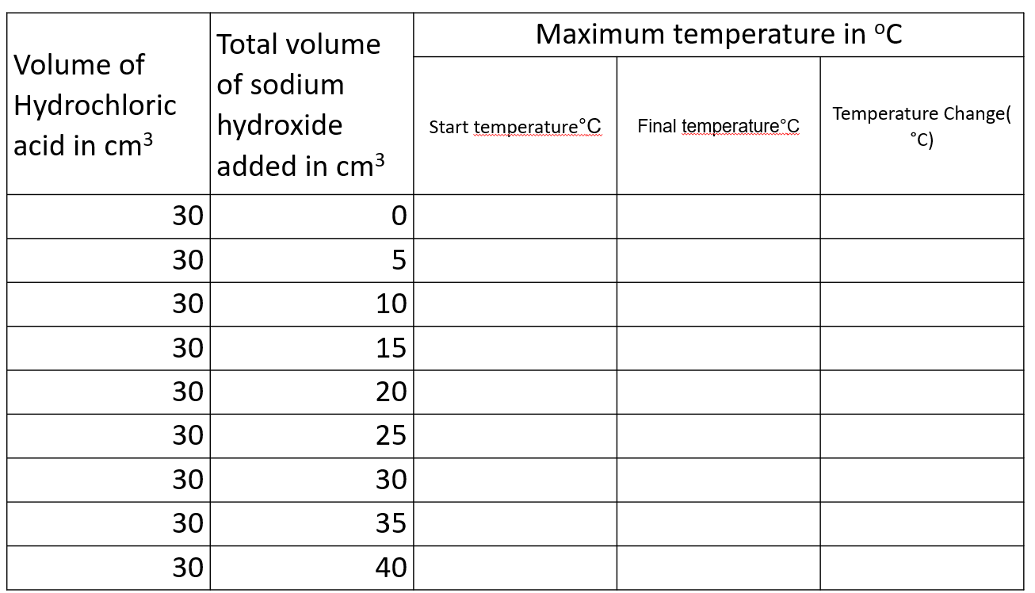
Results

Slide 10
Results

Slide 11
Risk assessment
Wear goggles at all times.
Dilute hydrochloric acid and Sodium Hydroxide are corrosive and be very damaging to the eyes - If contact occurs inform the teacher immediately
Tie long hair back
Ensure stools/chairs are tucked in and the working area is clear from bags,

Slide 12
Hypothesis
Independent variable
Dependent variable
Control variable
I predict that the temperature will go up when we mix acid with alkali
Volume of alkali
Temperature
Polystyrene cups

Slide 13
Results
Draw a graph of your results with the volume of sodium hydroxide solution(the independent variable) on the x-axis and the temperature change (the dependent variable) on the y-axis.

Slide 14
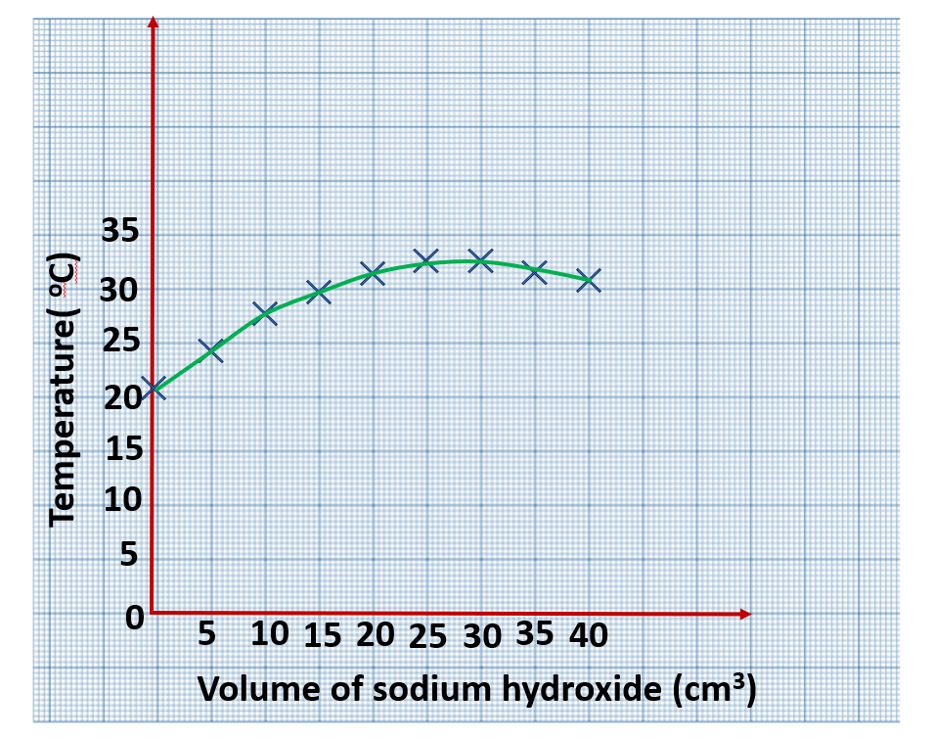

Slide 15
Evaluation
What volume of hydrochloric acid and sodium hydroxide produce the largest temperature change.
Why does the temperature fall towards the end
No reaction is taking place,the acid is used up and the sodium hydroxide is in excess.
This excess of sodium hydroxide lowers the temperature.

